Slide 1
Pediatric Syndromes at an Adult Hospital- How to Manage Kids and Adults with Syndromes you are Unfamiliar with
Alyssa Brzenski, MD

Slide 2
Objectives
Understand the impact that transitions of care from pediatric to adult hospitals and surgery centers has on all members (patient, parents, anesthesiologist)
Consider some unique aspects of perioperative care for adults with chronic health conditions
Explore different non-IV premedication options
Learn about some syndromes that might be seen in the perioperative period
Understand how to obtain additional information for syndromes that are unfamiliar

Slide 3
Incidence/Prevalence of Children surviving into adulthood
Increased survival of many childhood syndromes into adulthood
500,000 - 750,000 young people with syndromes and chronic illnesses become adults each year (1,2,3)
Increased cost and length of stay when these patients continue to be treated in children’s hospitals (4,5)
Familiarity of the syndromes are beneficial, but lack of infrastructure to provide adult care at children’s hospitals is problematic

Slide 4
Transitions of Perioperative Care from Pediatric Hospitals to Adult Hospitals
As these children with chronic illnesses age, anesthesiologists will see them in the perioperative area
Familiarity with challenges of these patients and their families will be required

Slide 5
Differences between Pediatric Perioperative Care and Adult Periop Care
Parents are encouraged to be present at most stages of care
Children are treated by age and maturity level with differential approach based on each of these items
Inhaled inductions rather than awake IV placement is common
Non-IV premedication is common
Some procedures are done under anesthesia rather than awake

Slide 6
A Family’s Experience on receiving care in an Adult Hospital
“We end up retraining new providers and staff on what to expect with my guys. I am also prepping my sons for the new experience. It takes some work. I find going through everything one more time can be overwhelming For many families, the fact that you have to engage with one more person about your sons’ or daughters’ medical issues and/or deficits can be daunting.”
- Marie Crawford, mom to two sons with chronic medical issues, including one son with Trisomy 21 and another son with autism who communicates nonverbally
Notes:
Practical Steps to Help Transition Pediatric Patients to Adult Care- Pediatrics Vol 144, Issue 6. Dec 2019.

Slide 7
Concerns from the Families and Patients
Lack of understanding of their chronic disease
Lack of coordination of care amongst the treating teams
Lack of individualized, family care

Slide 8
Considerations
Inability to tolerate check in and standard induction
Need for a premedication
Equipment availability
Comfort of ancillary staff to help
Lack of familiarity with comorbidities or sequelae of the syndrome
Consent- who is the consenting party?

Slide 9
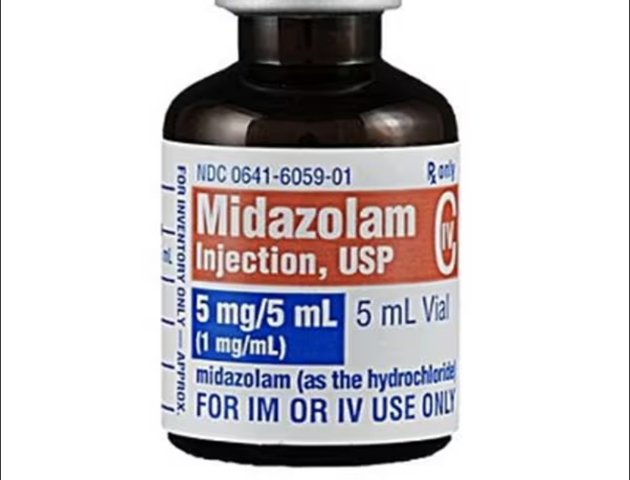
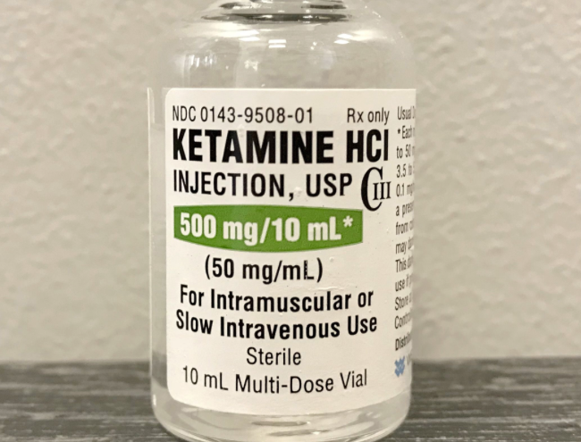
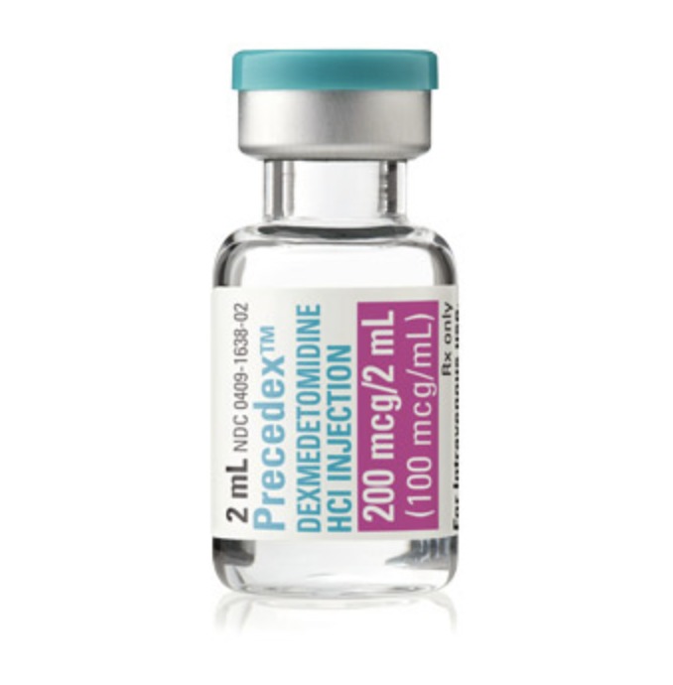
Premedication Options
Oral: most common route
Bitter taste
Dose: 0.25 - 1 mg/kg (20 mg max)
Onset: 10 - 15 min
Peak effect: 20 - 30 min
Intranasal
Very unpleasant burning sensation
Dose: 0.2 - 0.5mg/kg
Onset: 10 - 20min
Oral dosing 3 – 8 mg/kg
IM dosing 4 – 5 mg/kg
Effective sedation in about 5 minutes
45 minutes duration of action
Can combine 2-3 mg/kg + midazolam 0.1mg/kg
Side effects: excessive salivation, nausea/vomiting, nystagmus, and hallucinations
Intranasal/sublingual/buccal: 1 to 4 mcg/kg
IM: 2.5 mcg/kg
Oral: 3 - 4 mcg/kg but low bioavailability

Slide 10
Examples of Syndromes you might see
Trisomy 21
CHARGE Syndrome
Muscular Dystrophy
Crouzon Syndrome
Severe Autism Spectrum

Slide 11
Trisomy 21
Although developmental delay is present, children and adults with trisomy 21 frequently are very friendly and easy to engage
Pre-op considerations:
Congenital Heart Disease- Daily activity, EKG, follow up on any recent ECHOs
Atlanoaxial instability- 20% of patients- care with airway manipulation
OSA- due to obstruction at multiple areas in the upper airway
Intra-operative considerations:
Bradycardia with mask induction- prepare with atropine
Difficult PIV and A-line placement
Previously thought to have increased risk of difficult airway, but recent studies has not supported this- may consider videolaryngoscopy to minimize neck movement

Slide 12
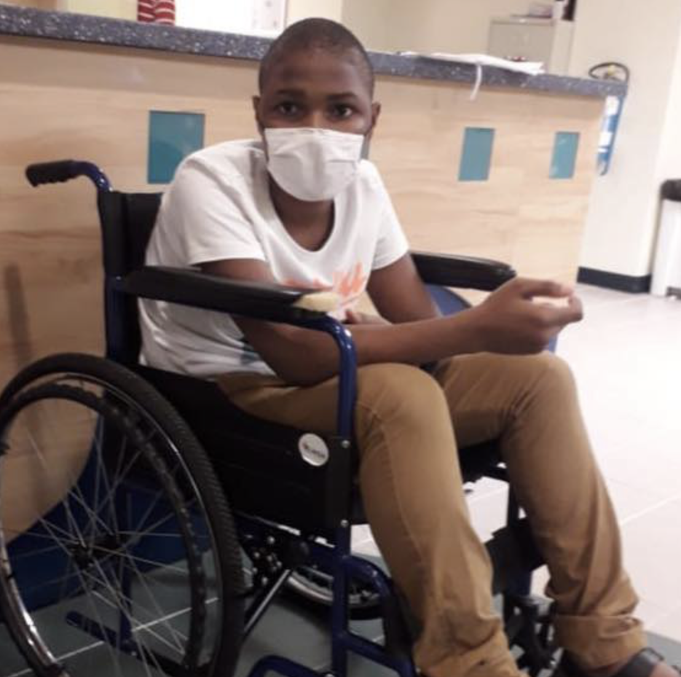
Duchenne Muscular Dystrophy
Absent dystrophin protein, resulting in increased muscle breakdown and elevated CK
Cardiomyopthy, restrictive and hypoventilatory respiratory failure
Pre-op:
EKG and ECHO
Evaluate existing PFTs and understand baseline respiratory support
Baseline CPK
Intra-op:
At risk for acute rhabdomyolysis from inhaled anesthetics and sux
Not a true risk for MH
Recommend running a TIVA with a ”clean machine”
Notes:
Current recommendations for Duchenne MD are to have a cardiac evaluation every 2 years after diagnosis and every year after the age of 10. Early utilization of angiotensin-converting enzyme inhibitors, diuretics, and B-adrenergic blockers may result in ventricular remodeling and functional improvement.

Slide 13
CHARGE Syndrome
Major Criteria
Coloboma
Chonal Atresia
Cranial nerve dysfunction
Ear anomalies- external and middle ear
Minor Criteria
Developmental Delay
Cardiovascular (Heart) anomalies
Growth (Retarded) deficiency
Cleft Lip/Palate
TEF
Facial dysmorphology
Genital Anomalies
Typical CHARGE syndrome- 3 major or 2 major + 2 minor
Partial CHARGE syndrome- 2 major + 1 minor

Slide 14
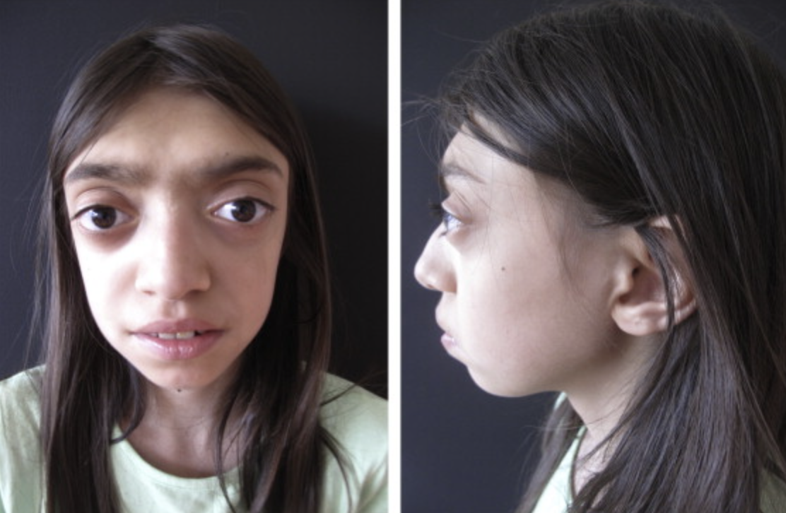
Crouzon Syndrome
A disorder associated with premature closure of the cranial sutures due to mutation of FGFR gene
Hypertelorism, frontal bossing, midface hypoplasia
Preop:
May have anxiety from multiple past procedures
OSA common- care with sedatives
Intra-op:
Difficult mask ventilation may be present
Difficult intubation possible

Slide 15
Autism Spectrum Disorder
1 in 88 children are diagnosed with ASD
Broad spectrum and patients may have different behavioral differences
Early discussion with the parents before the anesthetic can be valuable- create a plan for getting into the hospital and then into the operating room
Flexibility with premedication/ parental inductions
May need a quiet environment in the PACU

Slide 16
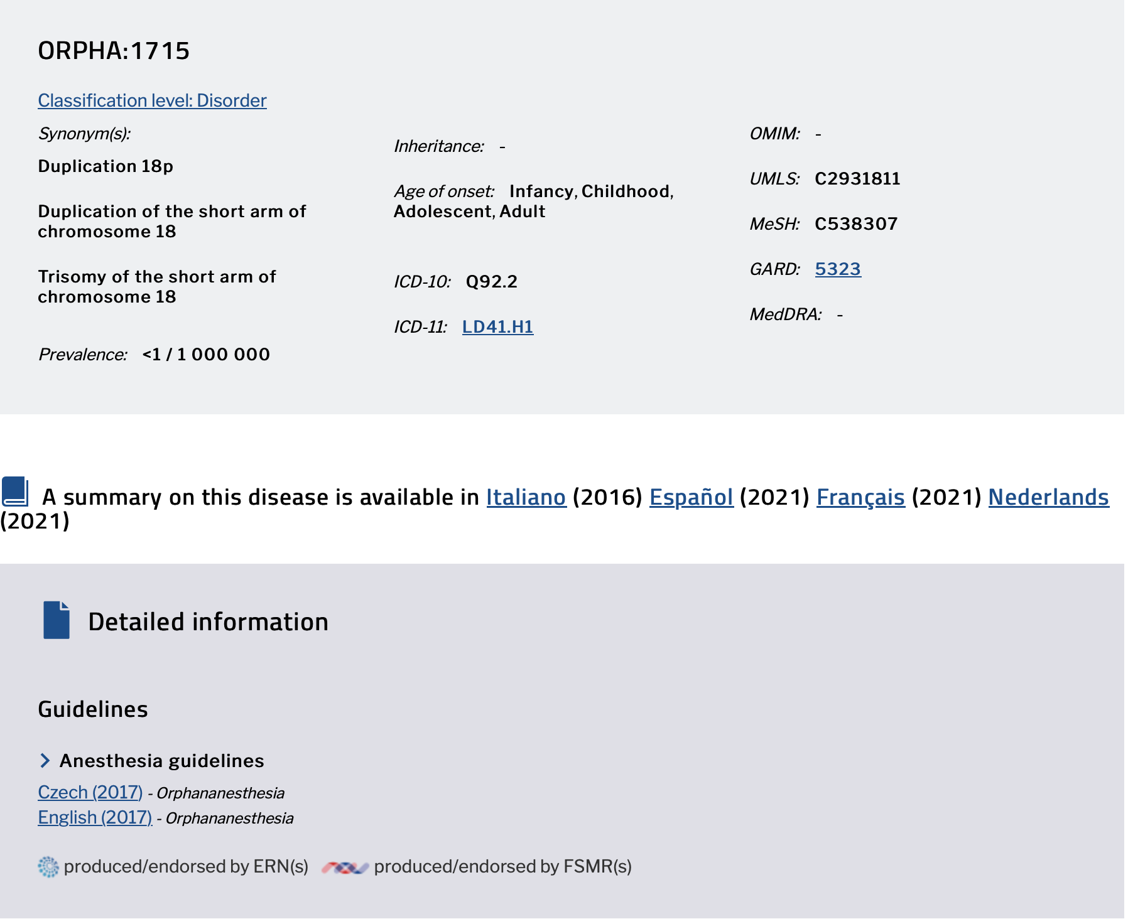
www.Orpha.net

Slide 17
References
Goodman DM, Hall M, Levin A, et al. Adults with chronic health conditions originating in childhood: inpatient experience in children’s hospitals. Pediatrics. 2011;128(1):5-13.
Lotstein DS, McPherson M, Strickland B, Newacheck PW. Transition planning for youth with special health care needs: results from the National Survey of Children with Special Health Care Needs. Pediatrics. 2005;115(6):1562-1568.
Scal P, Ireland M. Addressing transition to adult health care for adolescents with special health care needs. Pediatrics. 2005;115(6):1607-1612.
Okumura MJ, Campbell AD, Nasr SZ, Davis MM. Inpatient health care use among adult survivors of chronic childhood illnesses in the United States. Arch Pediatr Adolesc Med. 2006;160(10):1054-1060.
Kinnear B, O’Toole JK. Care of adults in children’s hospitals: acknowledging the aging elephant in the room. JAMA Pediatr. 2015;169(12):1081-1082.
Hart LC, Crawford M, Crawford P, Noritz G. Practical steps to help transition pediatric patients to adult care. Pediatrics. 2019;144(6):e20190373.
Laure B, Moret A, Joly A, et al. Orbitofrontal monobloc advancement for Crouzon syndrome. Journal of Cranio-Maxillofacial Surgery. 2014;42(6):e335-e338.
www.orpha.net

